Slide 1


WEBSITE EVALUATION
Mayurakhsa Sikdar
Saptarshi Ghosh
Aditi Chattopadhyay
Akash Kumar Gupta
Ankita Kundu
Arpita Bhattacharjee
Bhargav Ranjan
Indrashis Chatterjee
Md Aamir Khan
Raka Mitra
Ritwika Banerjee
Sayak Suvra Samanta
Sourav Bhowmick
Srimanta Roy Chowdhury
Suryai Majumder

Slide 2
CONTENTS
ABSTRACT
INTRODUCTION
FUNCTIONAL REQUIREMENTS
SYSTEM REQUIREMENTS
Hardware Requirement Specification
Software Requirement Specification
Data Flow Diagram
ER Diagram
Screen Shots
Test Cases
Future Scope
Conclusion
References

Slide 3
ABSTRACT
This project aims to develop a website for the evaluation of other
commercial (and non-commercial) websites. It will help the users
determine the popularity of the websites registered on this site and
help them take a decision of whether to trust these websites.

Slide 4
INTRODUCTION & OBJECTIVE OF THE PROJECT
The project builds a website for the evaluation of other websites. These
websites are validated by specialized people and then submitted to our
website, where users can submit their reviews. These reviews are then
analysed by an algorithm and given a rating. Thus the public opinions
about these websites help others to take appropriate decisions.

Slide 5
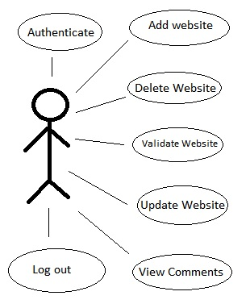
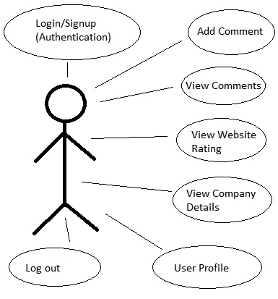
FUNCTIONAL REQUIREMENTS
Functional Requirements are those that refer to the functionality of the system, i.e., what services it will provide to the user.
Use Case Diagrams
Admin
User

Slide 6
Use Case Descriptions
Performance requirements
Operating Constraints
Platform Constraints
Accuracy and Precision
Modifiability
Minimal Portability
Minimal Reliability
Security
Usability
Legal

Slide 7
SYSTEM REQUIREMENTS
Hardware Requirement Specification
CLIENT MACHINE |  | SERVER MACHINE
HDD | 200 MB | HDD | 320 GB
PROCESSOR | Pentium 4 or newer processor supporting SSE2 | PROCESSOR | Dual Core or newer processor
MEMORY | 512 MB | MEMORY | 2 GB

Slide 8
Software Requirement Specification
CLIENT MACHINE |  | SERVER MACHINE
Browser | Any Standard browser with JavaScript interpreter | Software | Apache
Client side markup/ scripting languages | HTML, JavaScript | Database Management Software | MySQL
 |  | Specification | MySQL-4.1

Slide 9
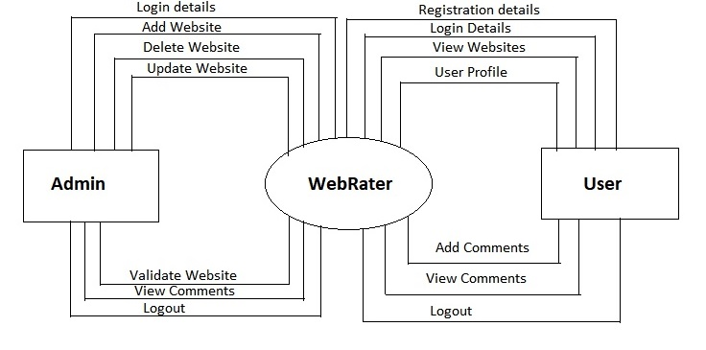
DATA FLOW DIAGRAMS
Level 0

Slide 10
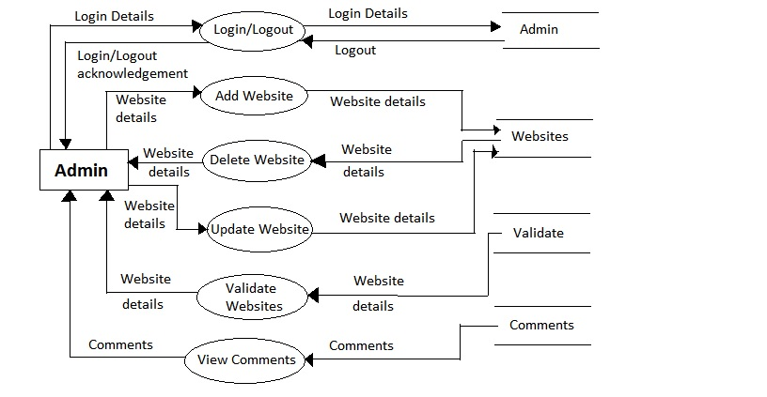
Level 1 for Admin

Slide 11
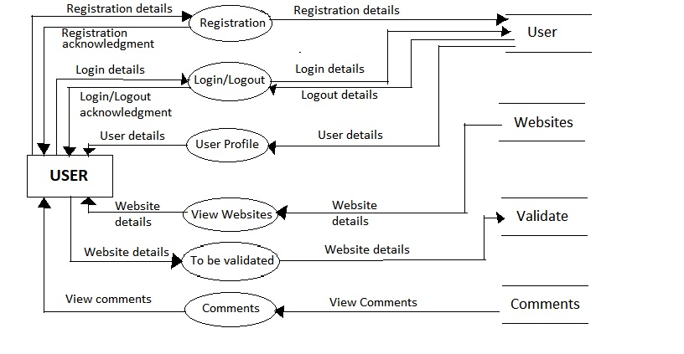
Level 1 for User

Slide 12
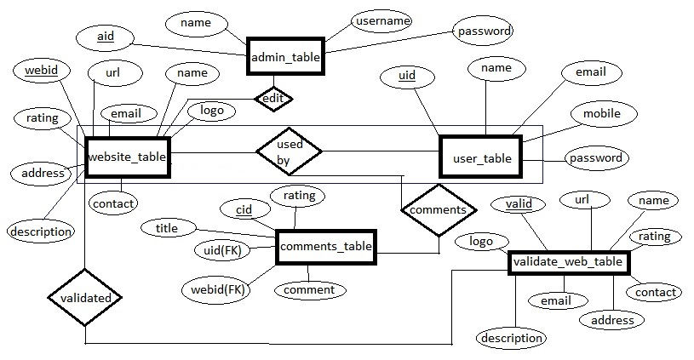
E-R DIAGRAM

Slide 13

SCREENSHOTS
User Panel
Home Page

Slide 14
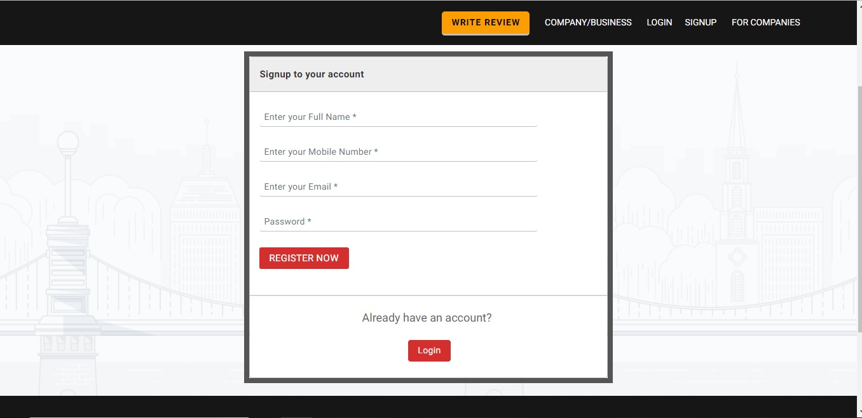
New User Registration

Slide 15
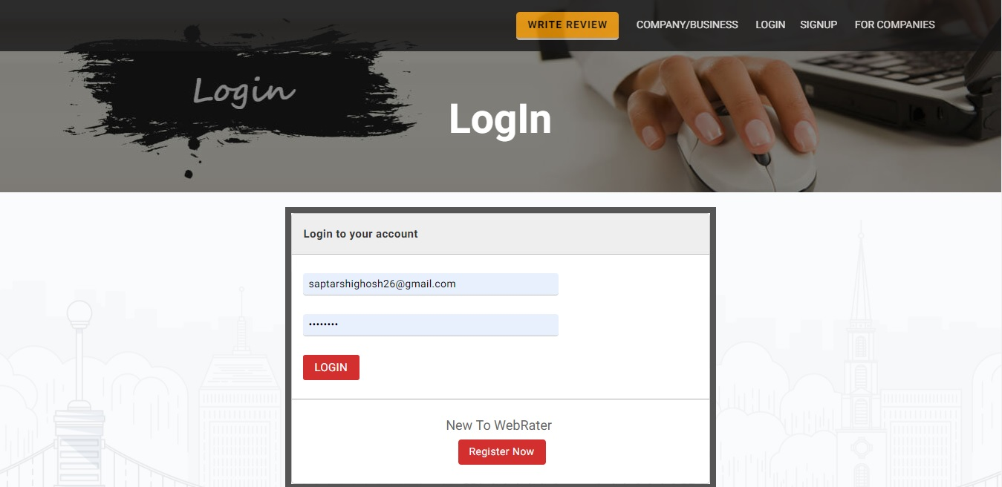
Log In

Slide 16
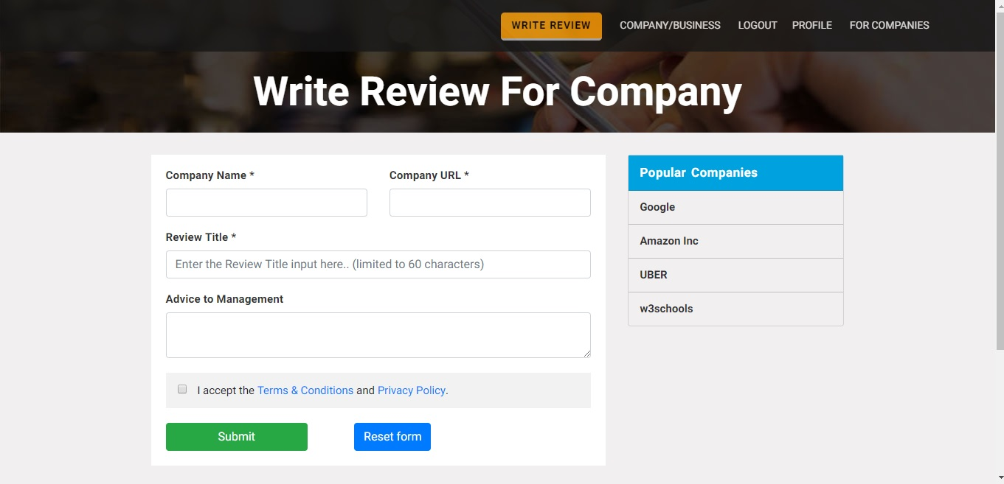
Write New Review

Slide 17
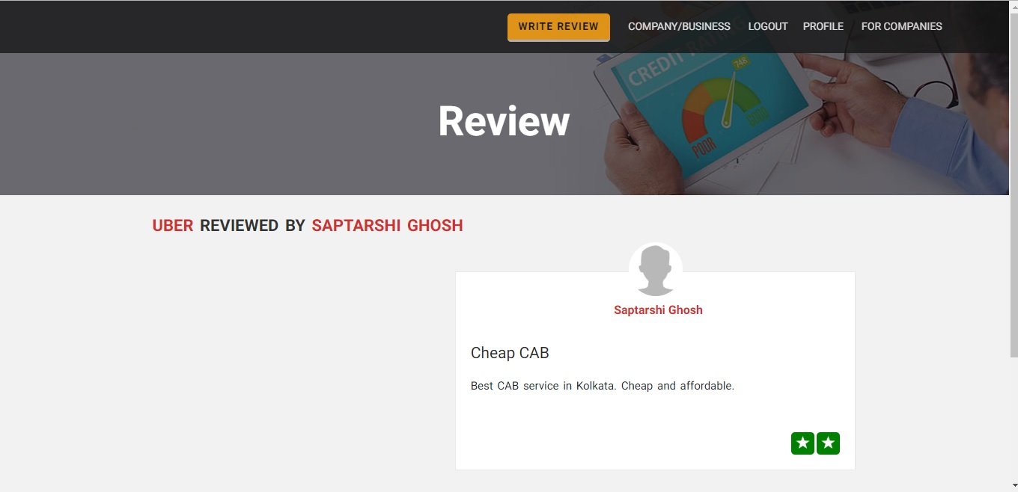
Individual Reviews Display

Slide 18
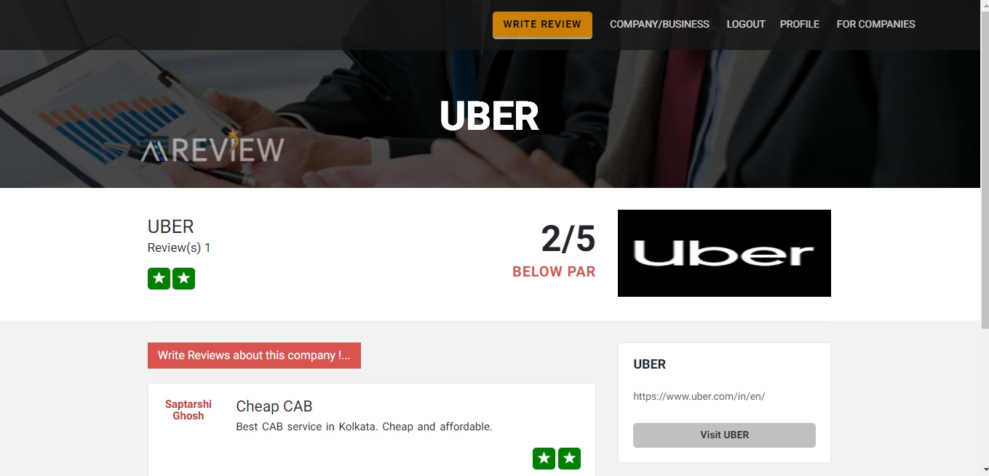
Company Reviews Page

Slide 19
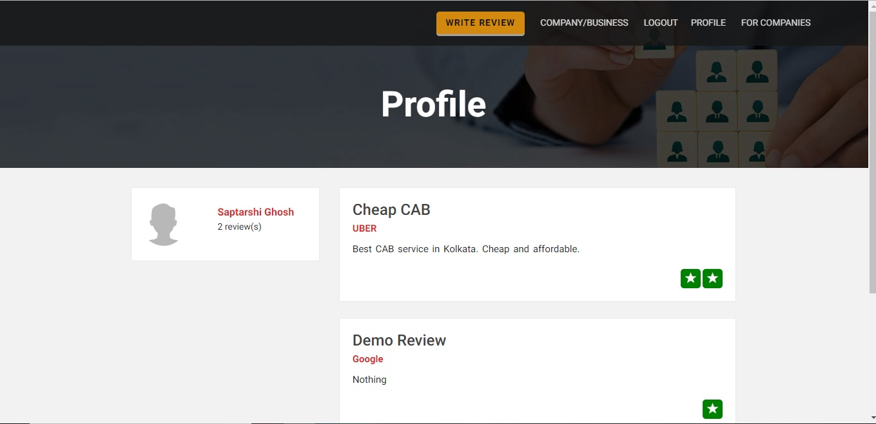
User Profile

Slide 20

Recent Reviews

Slide 21
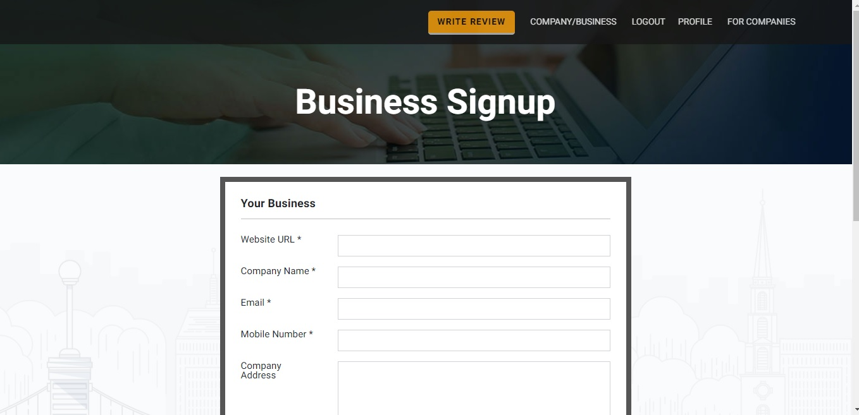
New Business Sign-up

Slide 22
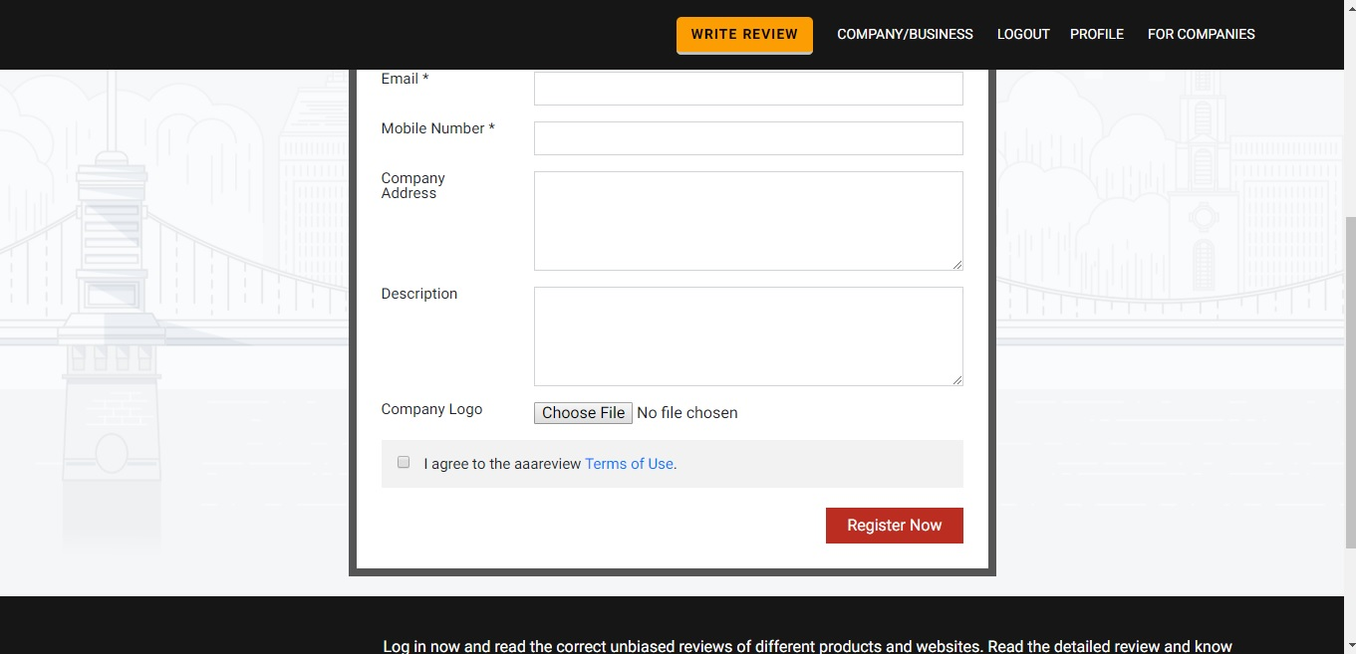
New Business Sign-up (contd.)

Slide 23
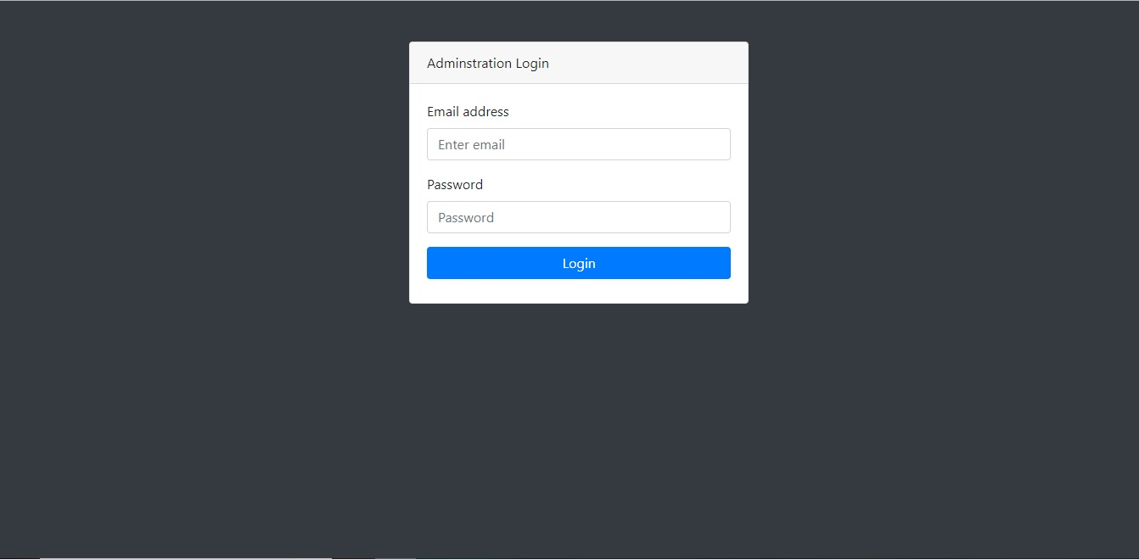
Admin Panel
Login

Slide 24
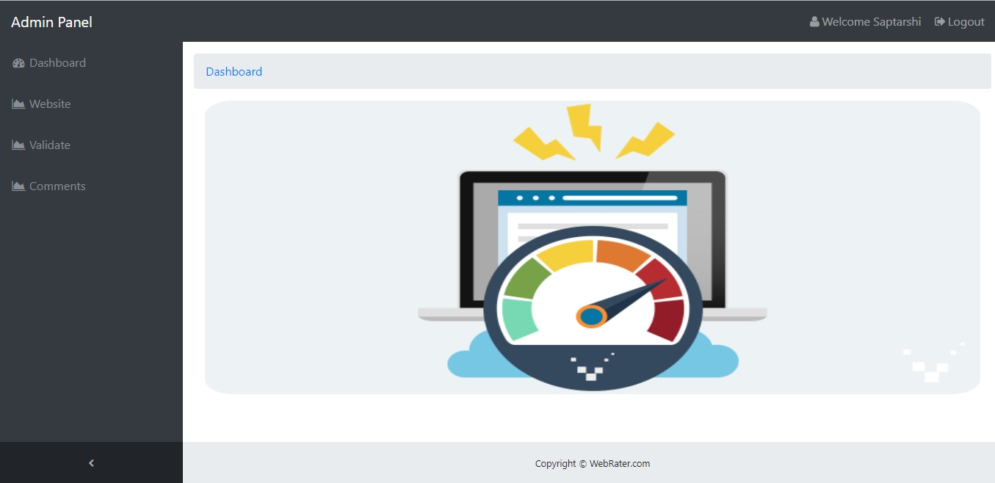
Dashboard

Slide 25
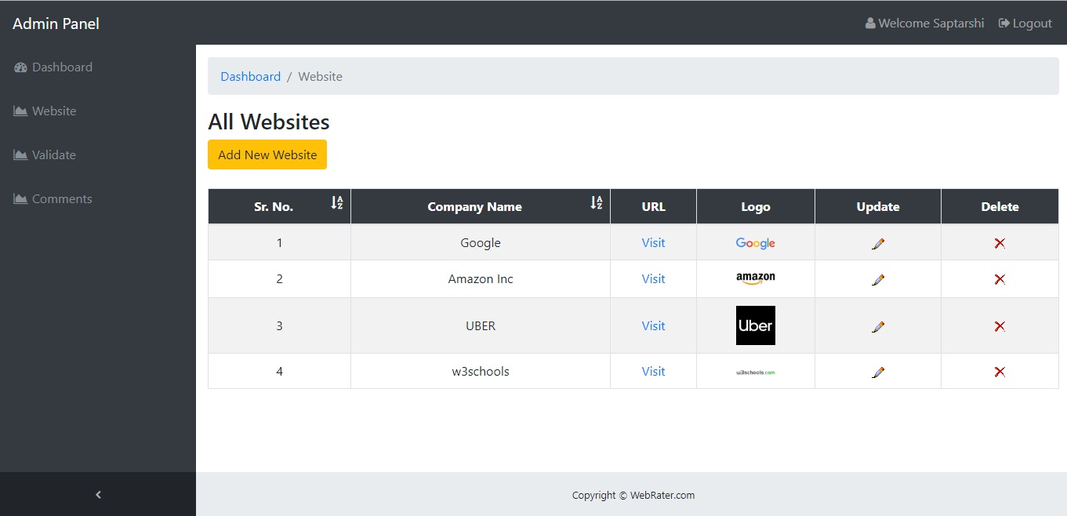
Websites

Slide 26
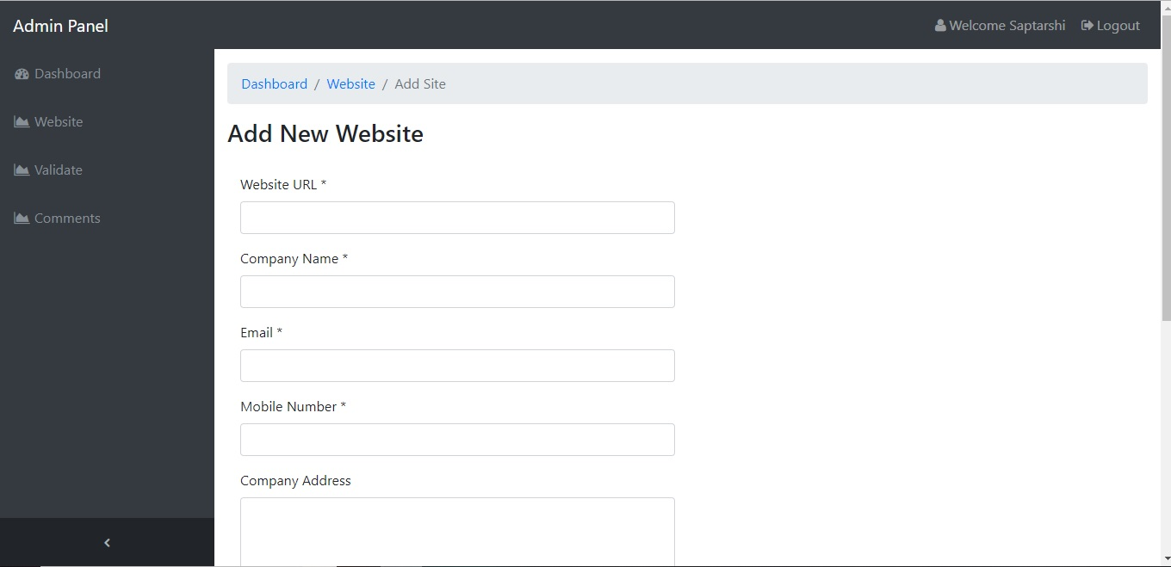
Add Websites

Slide 27
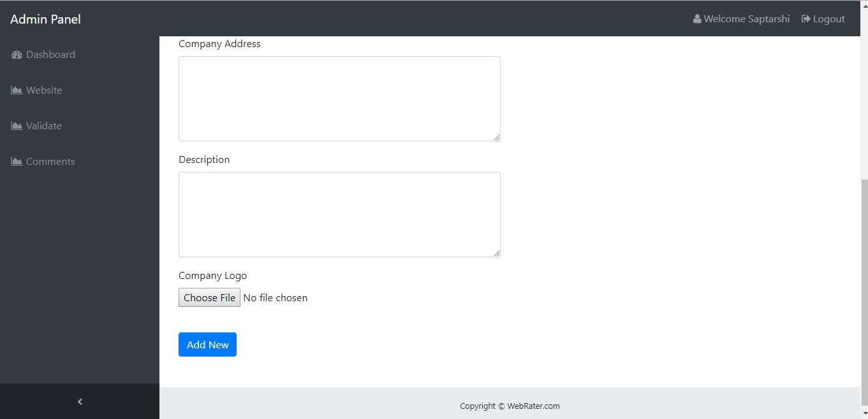
Add Websites (Contd.)

Slide 28
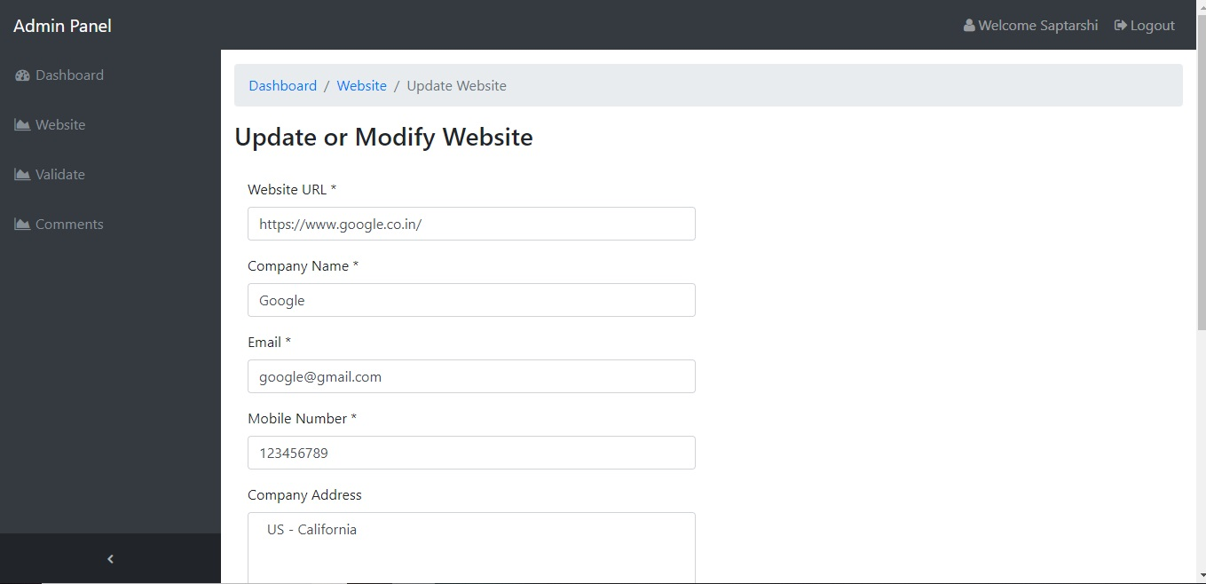
Update Websites

Slide 29
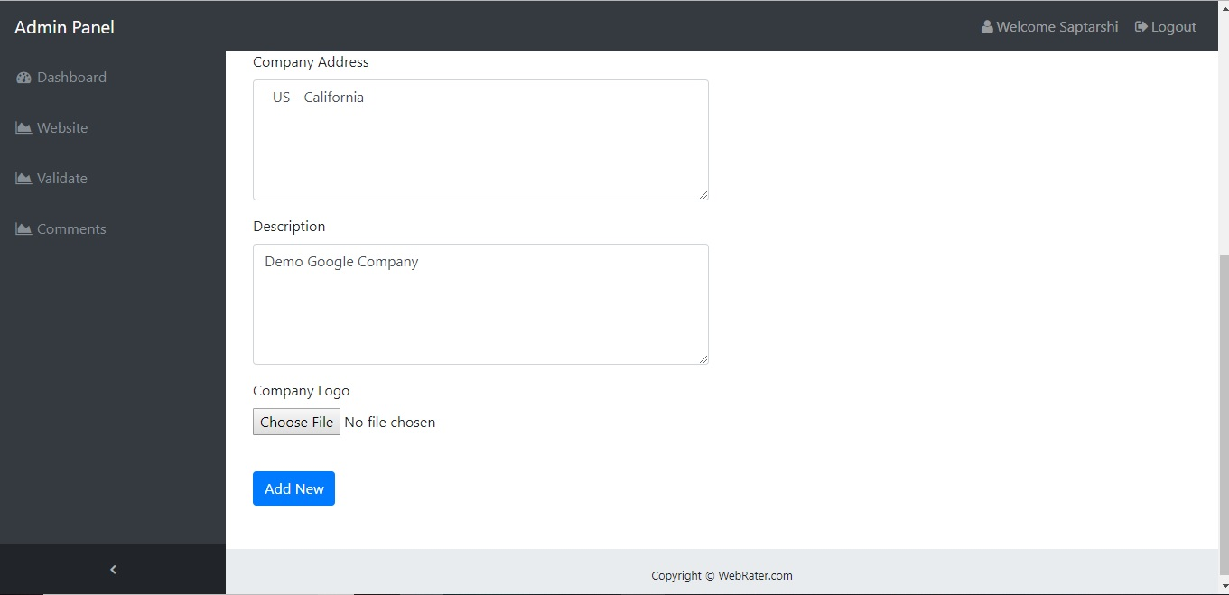
Update Websites (Contd.)

Slide 30
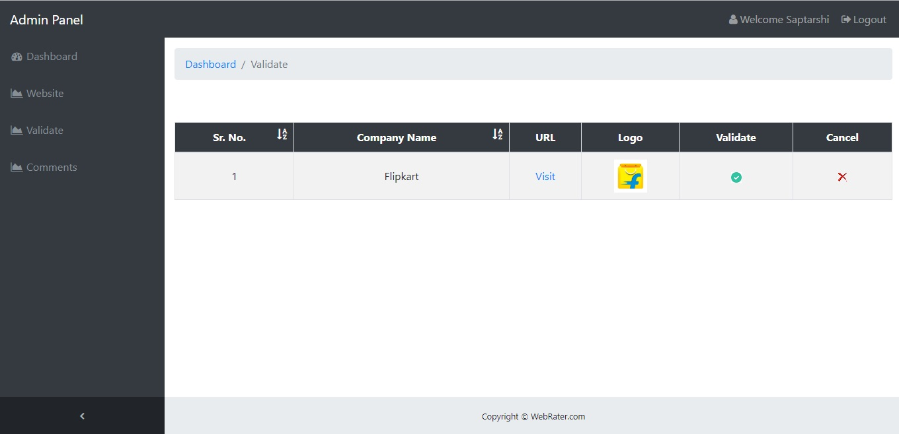
Validate Websites

Slide 31
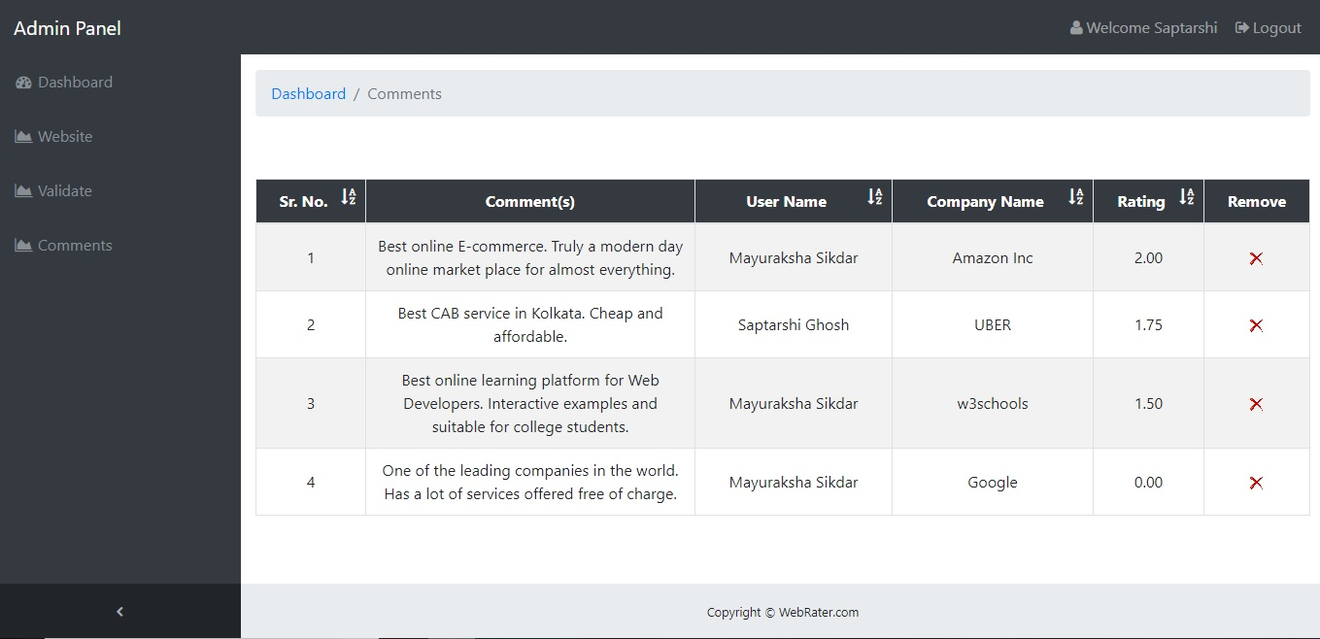
Comments

Slide 32
TESTING
Test Cases
Tested By : | Sayak Suvra Samanta
Test Type : | Unit Testing
Test Case Number : | 1
Test Case Name : | User identification
Test Case Description | Correct user id and password has to be entered to access further options. The test checks whether access is denied if incorrect user id and/or password is given.
Item(s) to be tested
1 | Verification of user id and password with the record in the database.
Specifications
Input | Expected Output/Result
Correct user id and password | Successful login
Incorrect user id and/or password | Failure Message

Slide 33
Tested By : | Sourav Bhowmick
Test Type : | Unit Testing
Test Case Number : | 2
Test Case Name : | New Website/Company sign-up
Test Case Description | While adding a new Website or Company, this test checks whether all the fields are correctly filled.
Item(s) to be tested
1 | Check whether all the fields are correctly filled
Specifications
Input | Expected Output/Result
Correct information given in the specific fields | Successful sign-up/registration
Incorrect user id and/or password | Failure Message

Slide 34
Tested By : | Arpita Bhattacharjee
Test Type : | Unit Testing
Test Case Number : | 3
Test Case Name : | User sign-up
Test Case Description | The user must add details for successful registration. The test checks whether an error message is given if all the mandatory fields are not filled.
Item(s) to be tested
1 | Check whether all the mandatory fields are filled up.
Specifications
Input | Expected Output/Result
Submission with mandatory fields filled. | Successful registration
Submission without all mandatory fields filled. | Error Message

Slide 35
Tested By : | Saptarshi Ghosh
Test Type : | Unit Testing
Test Case Number : | 4
Test Case Name : | Comments
Test Case Description | User searches for the website to comment on. This test verifies whether the website he comments on is registered on WebRater.
Item(s) to be tested
1 | Verification of website name with the record in the database
Specifications
Input | Expected Output/Result
Registered Website | User can move to comments section
Website not registered | Error Message

Slide 36
FUTURE SCOPE
More accurate Sentiment Analysis
Reply section for particular comment
New Admin creation using validation of all other admins
Anonymous comment (without Login)
More options for User Profile

Slide 37
CONCLUSION
This project provides a trusted and unbiased website for evaluating
other Websites/Companies. It operates on public opinion and then
uses an algorithm to evaluate those opinions (comments). Users can
use WebRater to decide for themselves how popular a website or
company is.

Slide 38
REFERENCES
https://www.w3schools.com
http://php.net/manual/en/tutorial.php
https://www.tutorialspoint.com/php/

Slide 39


